Slide 1

Introduction to Portfolio Management & Exchange Traded Derivatives MANG 6142 Lecture 2
Di Luo
d.luo@soton.ac.uk

Slide 2
Critical Concepts
Portfolio Mean
Portfolio Variance
Efficient Frontier
Tangible Portfolio
Global Min Risk

Slide 3
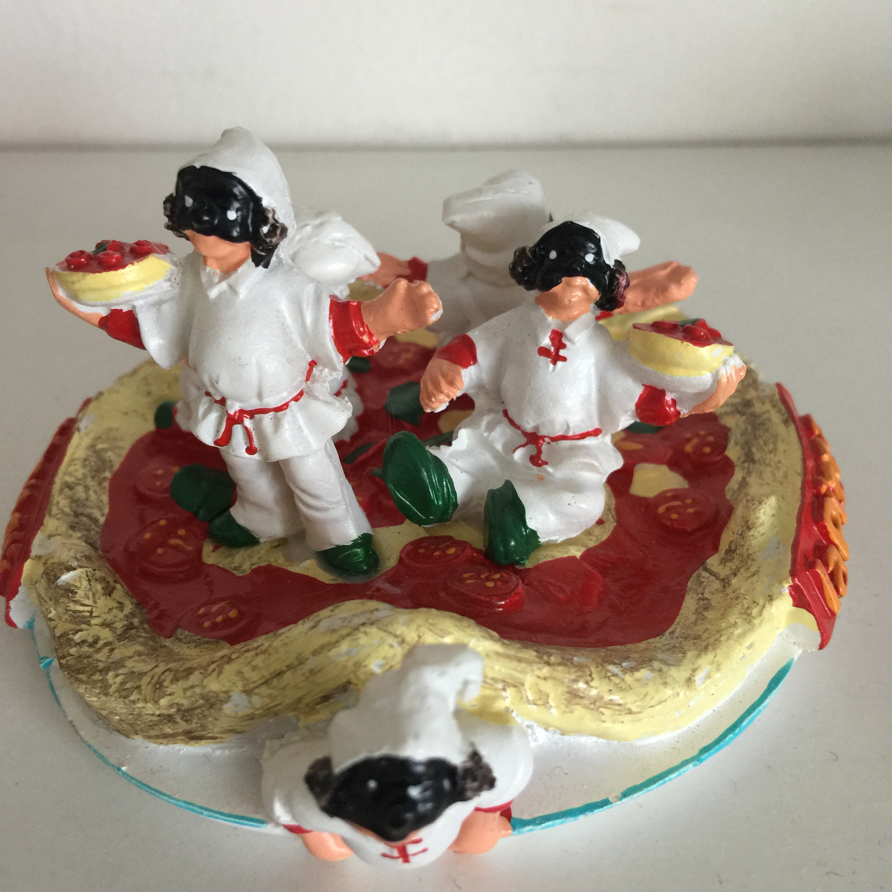
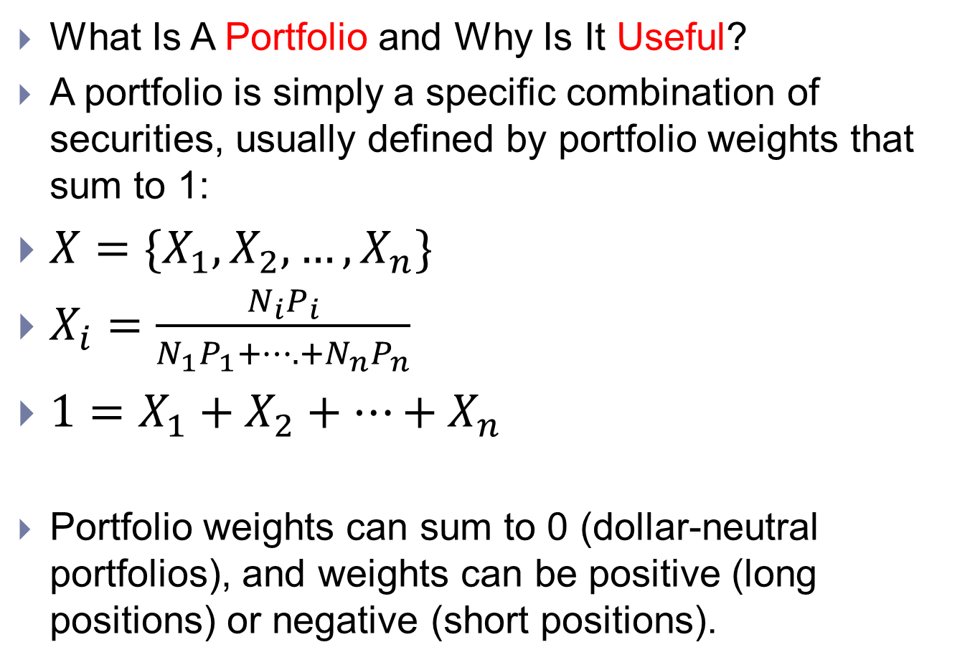
Motivation
What Is A Portfolio and Why Is It Useful?
A portfolio is simply a specific combination of securities, usually defined by portfolio weights that sum to 1:
$X=\{X_{1},X_{2},…,X_{n}\}$
$X_{i}=\frac{N_{i}P_{i}}{N_{1}P_{1}+….+N_{n}P_{n}}$
$1=X_{1}+X_{2}+…+X_{n}$
Portfolio weights can sum to 0 (dollar-neutral portfolios), and weights can be positive (long positions) or negative (short positions).

Slide 4
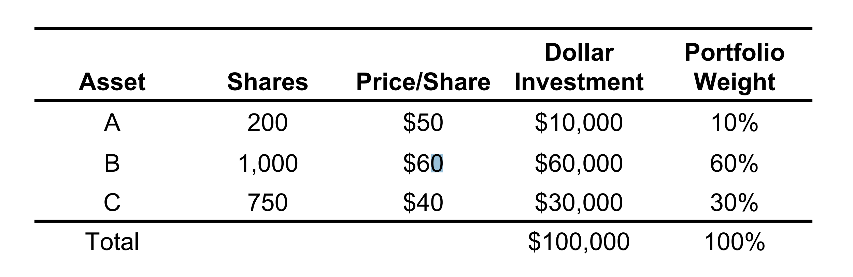
Example
You invest $100,000 in: 200 shares of stock A, 1,000 shares of stock B, and 750 shares of stock C. Your portfolio is summarized by the following weights:

Slide 5
You decide to purchase a home that costs £500,000 by paying 20% of the purchase price and getting a mortgage for the remaining 80% What are your portfolio weights for this investment?
Asset | Shares | Price/shares | Dollar Investment | Portfolio Weight
Home | 1 | £500,000 | £500,000 | 500%
Mortgage | 1 | -£400,000 | -£400,000 | -400%
Total |  |  | £100,000 | 100%

Slide 6
Motivation
Why Not Pick The Best Stock Instead of Forming a Portfolio?
We don’t know which stock is best!
Portfolios provide diversification, reducing unnecessary risks.
Portfolios can enhance performance.
Portfolios can customize and manage risk/reward trade-offs.
How Do We Construct a “Good” Portfolio?
What does “good” mean?
What characteristics do we care about for a given portfolio?
Risk and reward
Investors like higher expected returns
Investors dislike risk

Slide 7
Objective
Assume that investors focus only on the expected return and variance (or standard deviation) of their portfolios: higher expected return is good, higher variance is bad
Develop a method for constructing optimal portfolios

Slide 8
Chapter 4: The Characteristics of the Opportunity Set under Risk
Determining the Average Outcome
A Measure of Dispersion
Variance of Combinations of Assets
Characteristics of Portfolios in General

Slide 9
Statistical Background: Mean
Much of the modelling in finance uses ideas from probability theory.
We need to know few basic concepts to understand most of quantitative finance.
The first idea is that of the mean. The mean is the same as the average or the expectation.

Slide 10
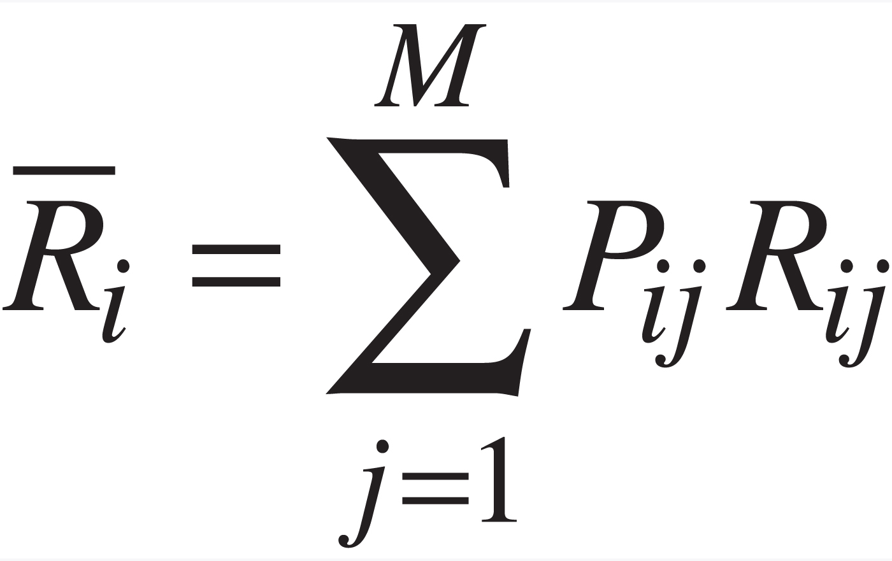
Pij is the probability of jth return on the ith asset

Slide 11
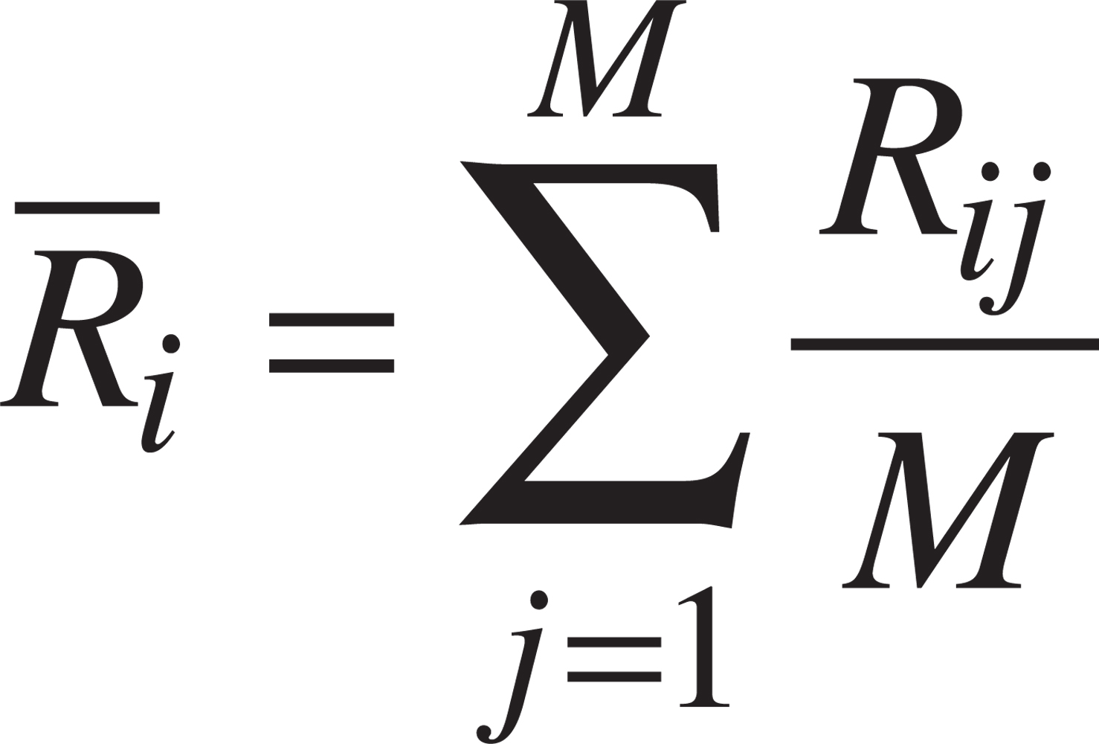
M equally likely returns for asset i

Slide 12
Statistical Background: Variance
Not only is it necessary to have a measure of the average return, but it is also useful to have some measure of how much the outcomes differ from the average.
Variance: A Measure of Dispersion

Slide 13
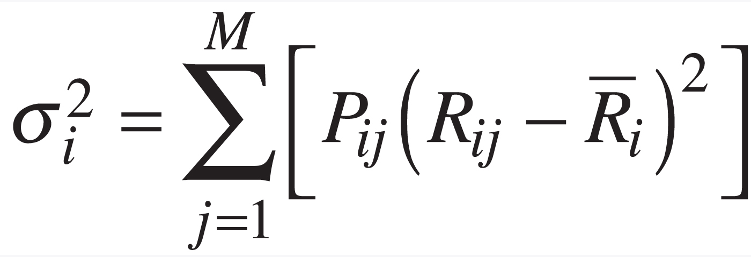
Pij is the probability of jth return on the ith asset

Slide 14
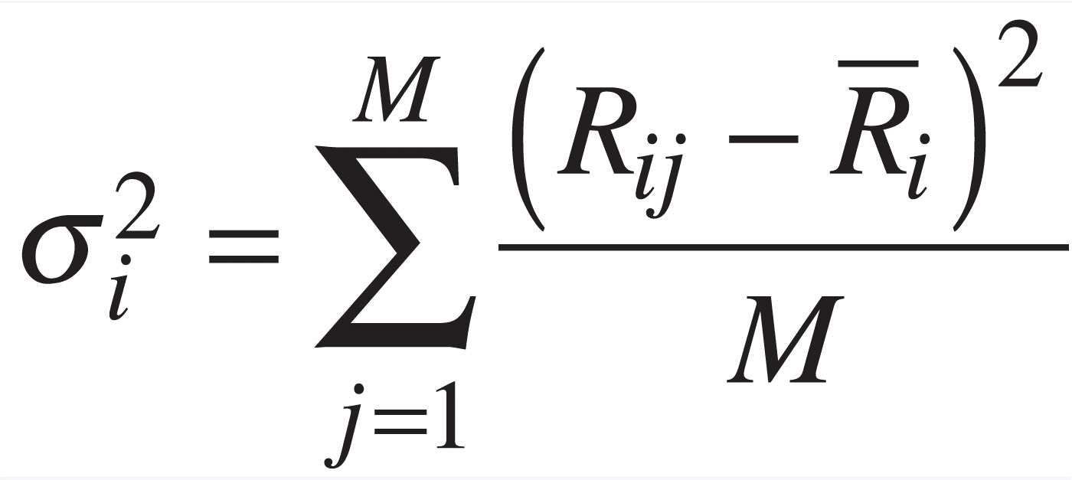
M equally likely returns for asset i

Slide 15
Variance and Standard deviation
Why standard deviation?

Slide 16
Properties of Expectations
Expectations have the following properties:
• E[cR] = cE[R]
• E[R1 +R2] = E[R1] + E[R2 ].

Slide 17
Properties of Variance
In finance, variance (and standard deviation) is often used as a measure of risk in an investment.
The higher the standard deviation of investment returns the greater the dispersion of the returns and the greater the risk.

Slide 18
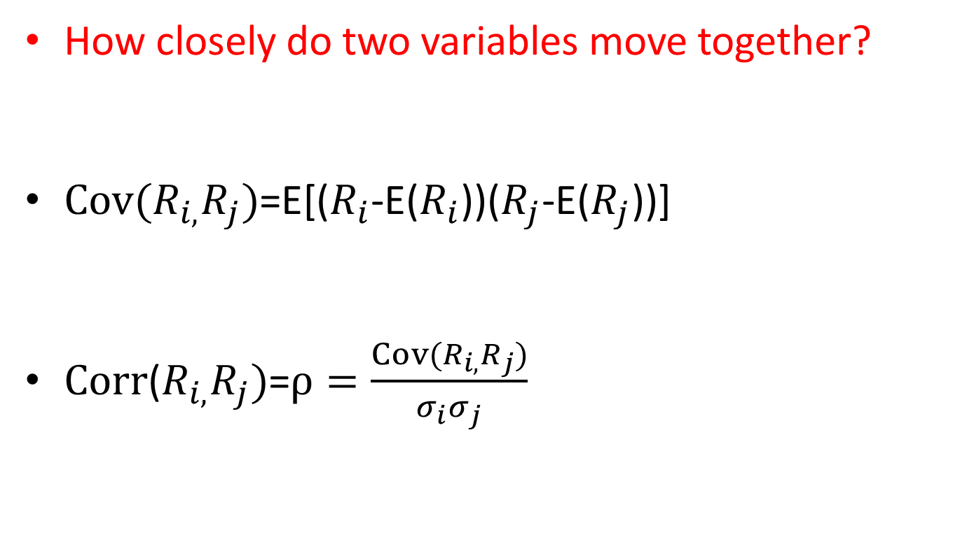
Covariance and Correlation
How closely do two variables move together?
$Cov(R_{i,}R_{j})$=E[($R_{i}$-E($R_{i}$))($R_{j}$-E($R_{j}$))]
$Corr$($R_{i,}R_{j})$=$ρ=\frac{Cov(R_{i,}R_{j})}{σ_{i}σ_{j}}$

Slide 19
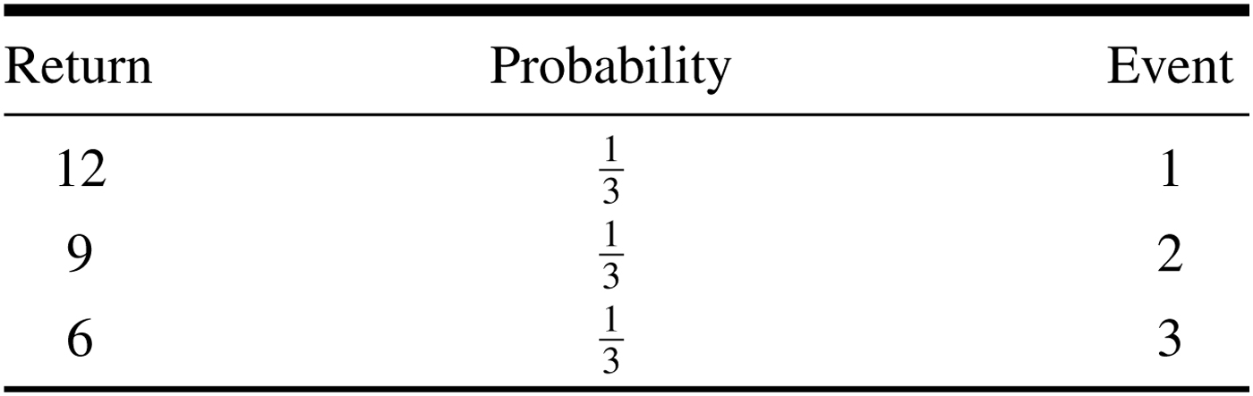
Example

Slide 20
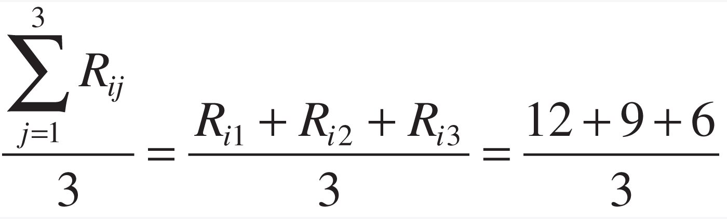
Equn_43

Slide 21
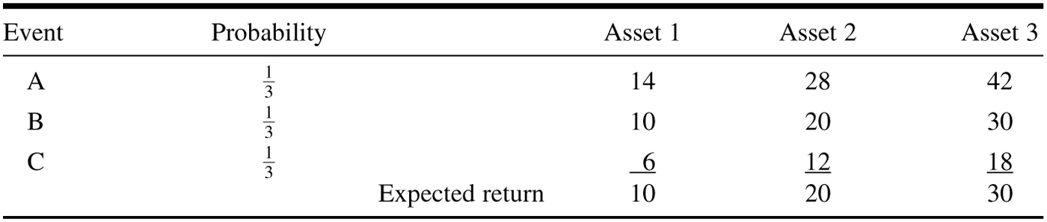
Table_4-2

Slide 22
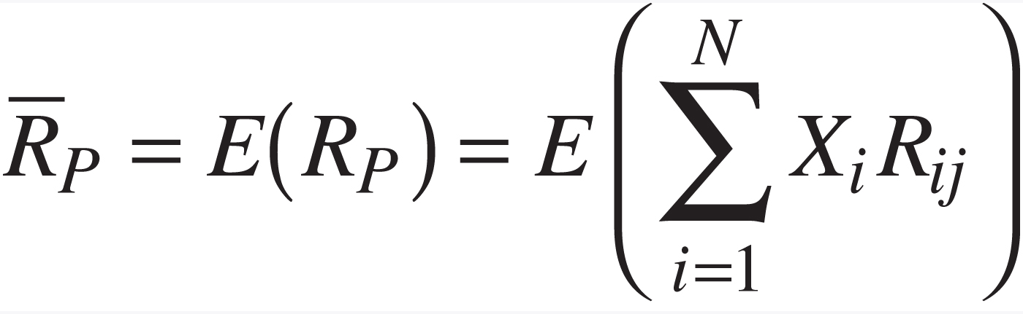
Characteristics of Portfolios in General
The return on a portfolio of assets is simply a weighted average of the return on the individual assets.

Slide 23
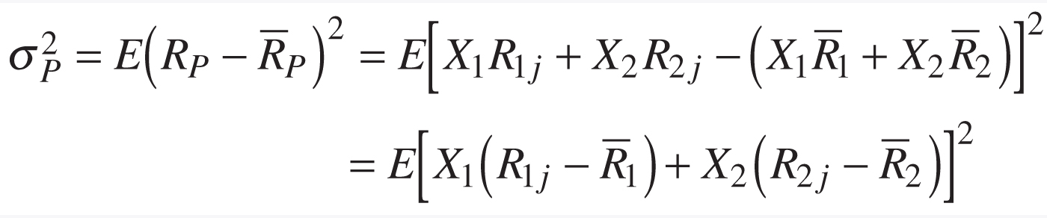
Portfolio variance: two assets example

Slide 24
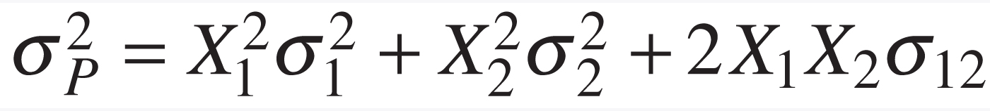
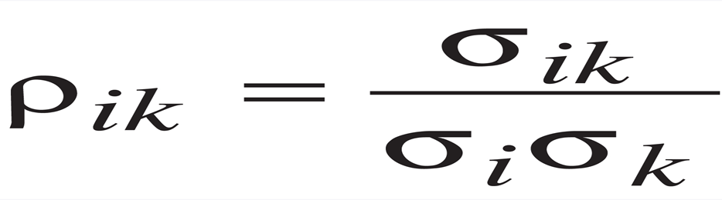
Correlation coefficient
Why? Between -1 and 1

Slide 25
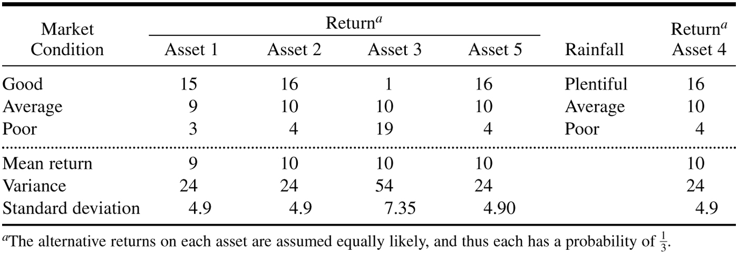
Table_4-3

Slide 26
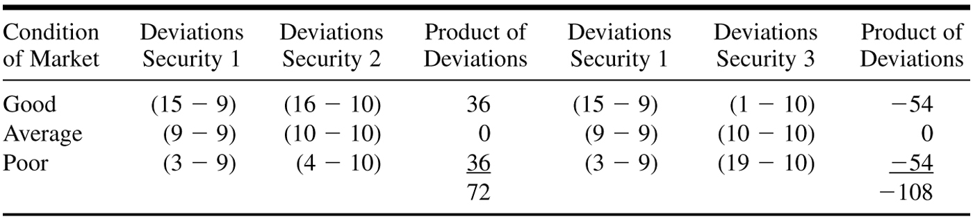
Table_4-6

Slide 27
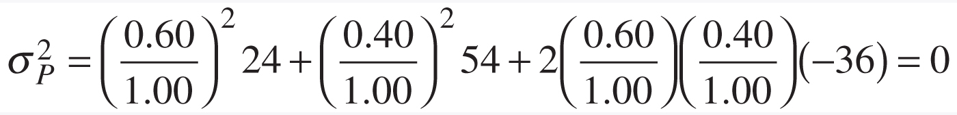
Example 1 pound to spend 0.6 on asset 1 and 0.4 and asset 3
Note that -108/3=-36

Slide 28
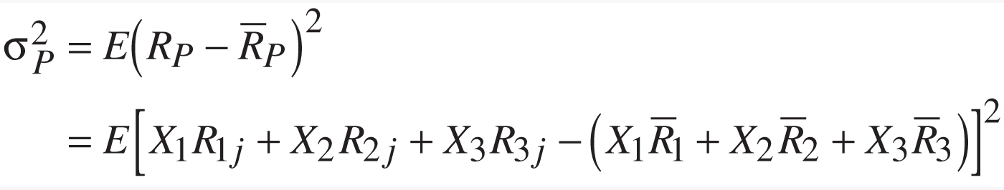
Portfolio variance: three assets example

Slide 29
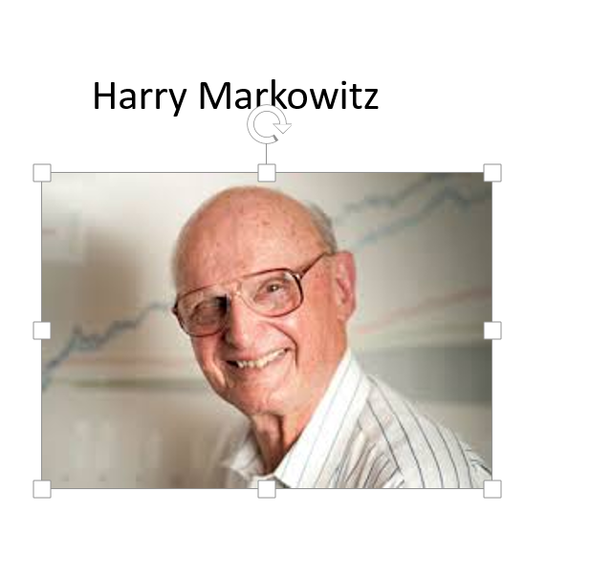
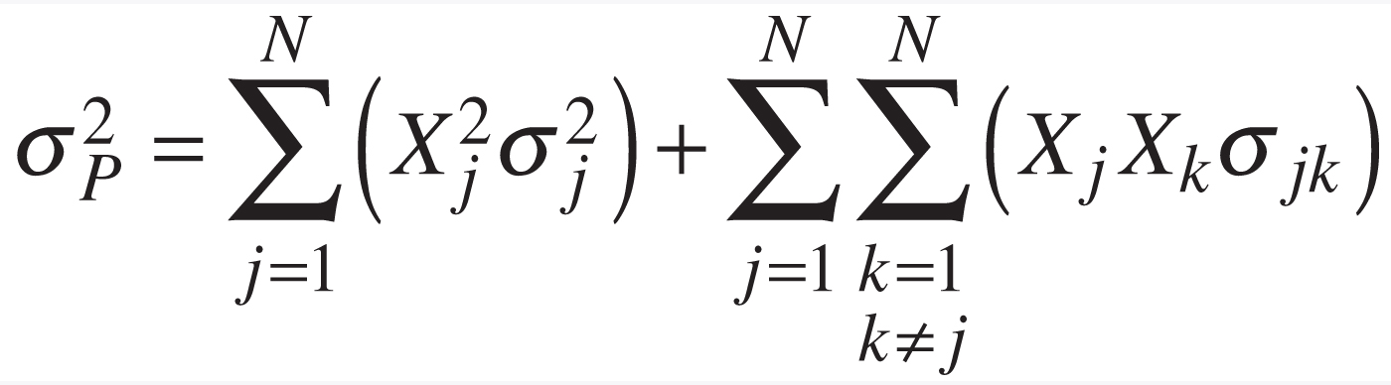
Portfolio variance: N assets
How mang terms do we have?

Slide 30
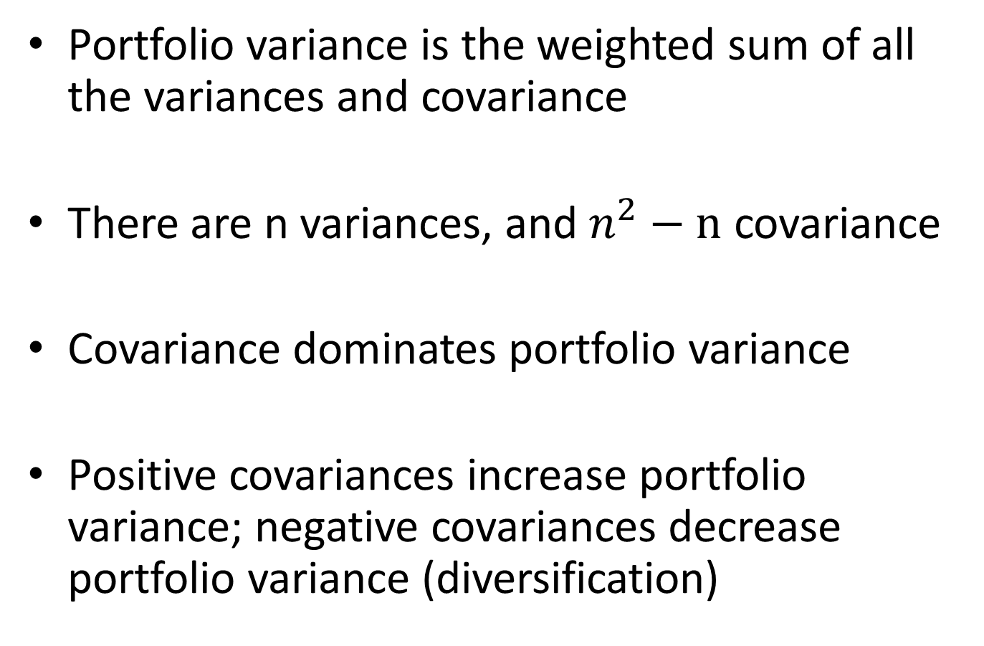
Portfolio variance is the weighted sum of all the variances and covariance
There are n variances, and $n^{2}−n$ covariance
Covariance dominates portfolio variance
Positive covariances increase portfolio variance; negative covariances decrease portfolio variance (diversification)

Slide 31
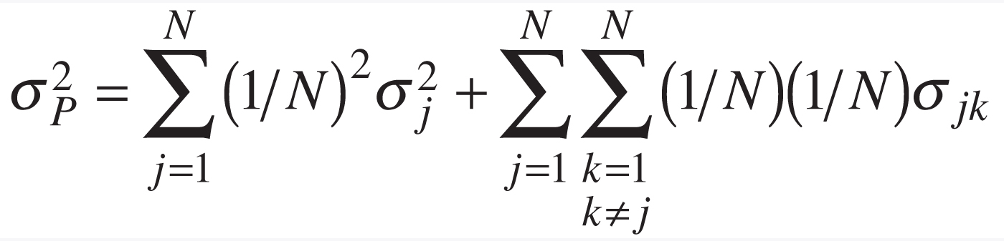
Equal investment case

Slide 32
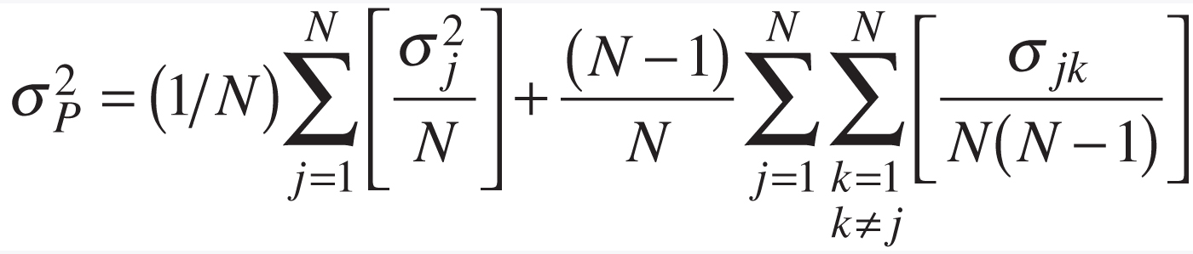

Slide 33
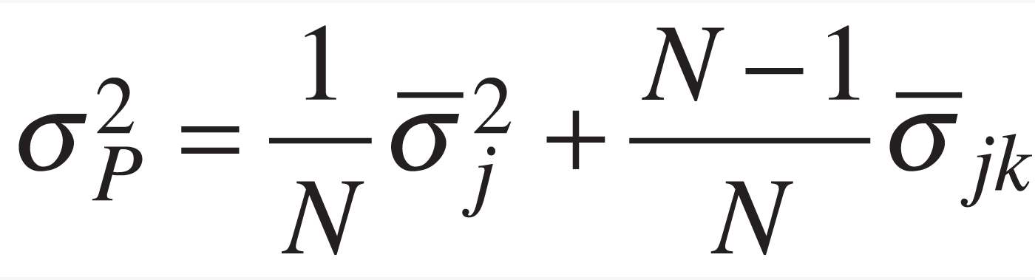
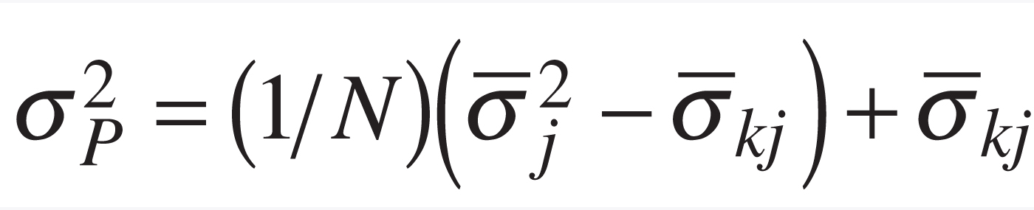
Equn_56f
For portfolios with many stocks, the variance is determined by the average covariance among the stocks

Slide 34
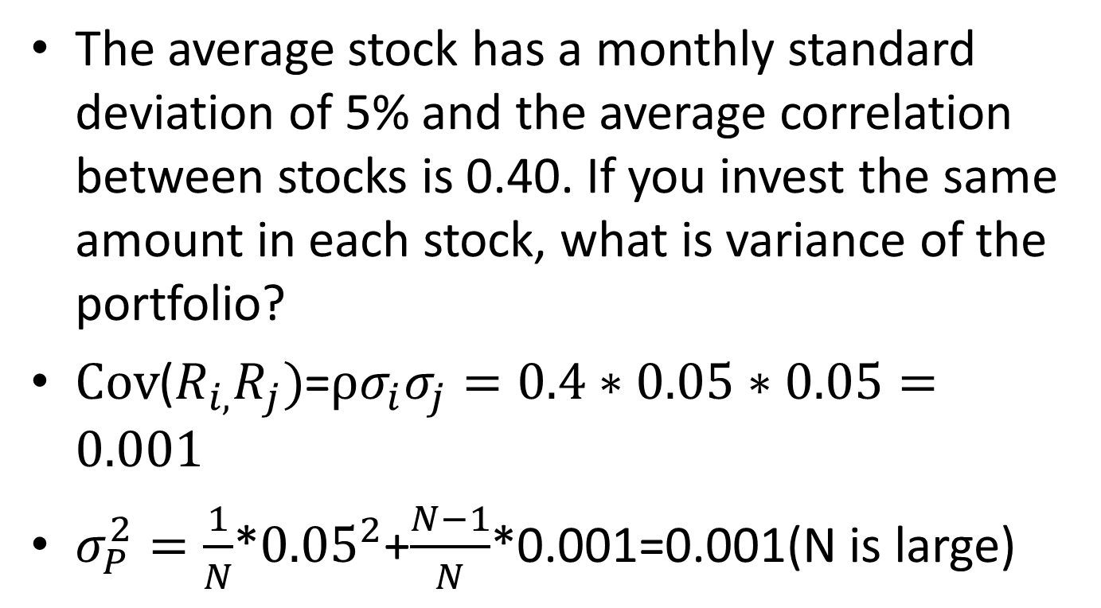
Example
The average stock has a monthly standard deviation of 5% and the average correlation between stocks is 0.40. If you invest the same amount in each stock, what is variance of the portfolio?
$Cov$($R_{i,}R_{j})$=$ρσ_{i}σ_{j}=0.4∗0.05∗0.05=0.001$
$σ_{P}^{2}=\frac{1}{N}$*${0.05}^{2}$+$\frac{N−1}{N}$*0.001=0.001(N is large)

Slide 35
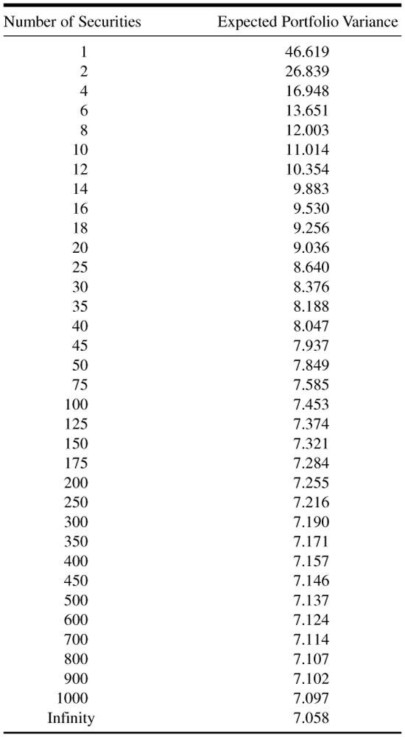
Table_4-8

Slide 36
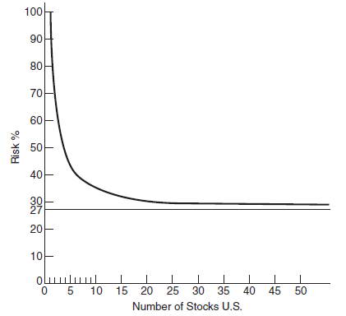
Figure 4.2 The effect of number of securities on risk of the portfolio in the United States (1975).

Slide 37
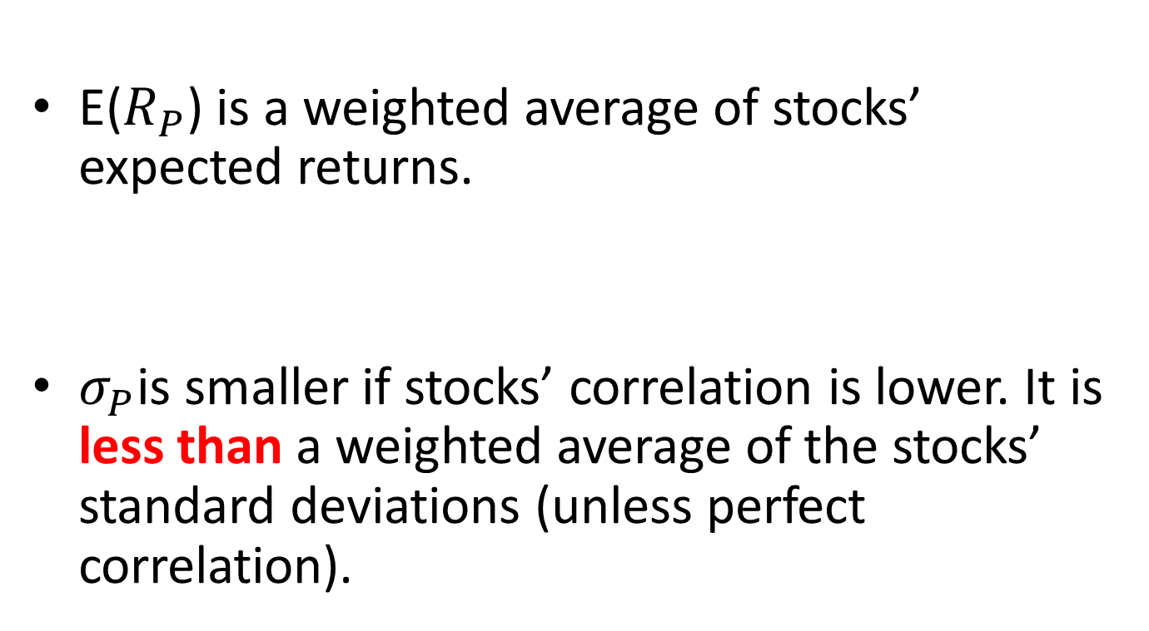
Summary
E($R_{P}$) is a weighted average of stocks’ expected returns.
$σ_{P}$is smaller if stocks’ correlation is lower. It is less than a weighted average of the stocks’ standard deviations (unless perfect correlation).

Slide 38
Chapter 5: Delineating Efficient Portfolios
Combinations of Two Risky Assets Revisited: Short Sales Not Allowed
The Shape of the Portfolio Possibilities Curve
The Efficient Frontier with Riskless Lending and Borrowing
Conclusion

Slide 39
Return and standard deviation space

Slide 40
Two assets example
Car vs utility
 | Expected Return | Std. Deviation
Colonel Motors(C) | 14% | 6%
Separated Edison(S) | 8% | 3%

Slide 41
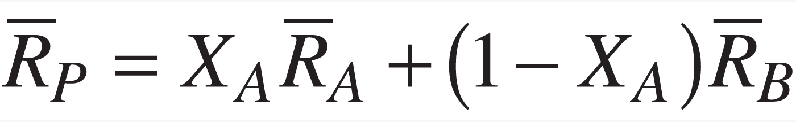
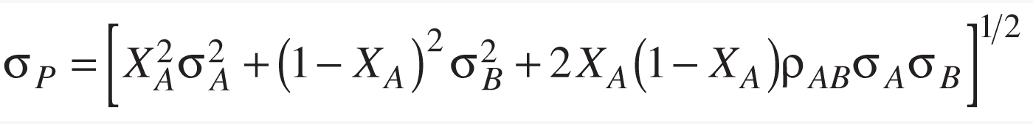
Return and standard deviation

Slide 42
Combinations of Two Risky Assets Revisited: Short Sales Not Allowed
Case 1 – Perfect Positive Correlation (p = +1)
Case 2 – Perfect Negative Correlation (p = -1.0)
Case 3 – No Relationship between Returns on the Assets (p = 0)
Case 4 – Intermediate Risk (p = 0.5)

Slide 43
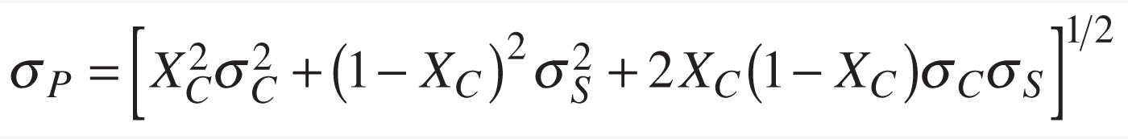
Case 1 – Perfect Positive Correlation (p = +1)

Slide 44
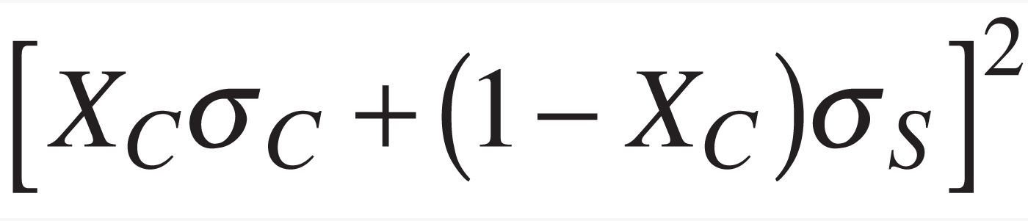
Equn_p67a

Slide 45
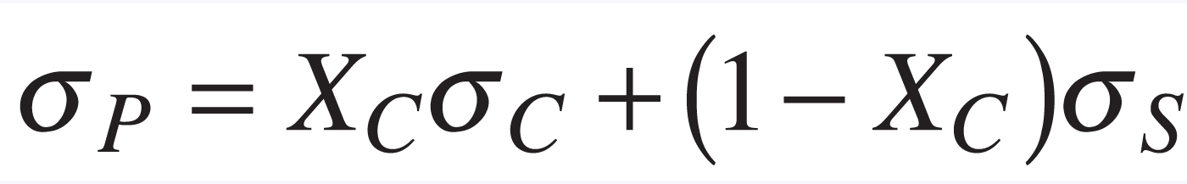
Equn_p67b

Slide 46
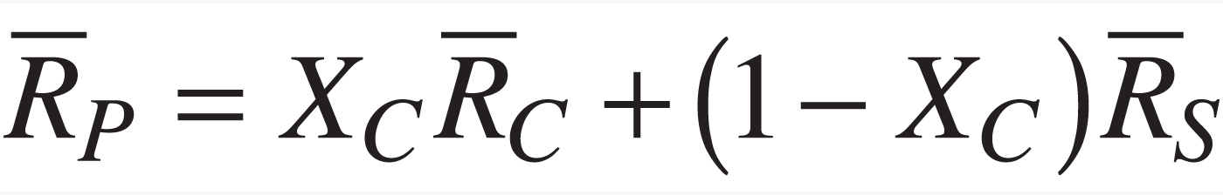
Equn_p67c

Slide 47
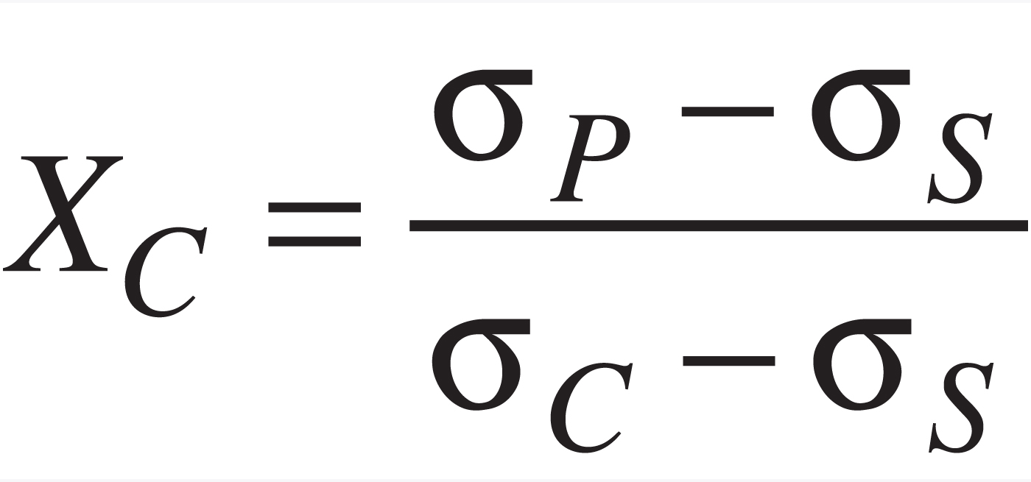
Equn_p67d

Slide 48
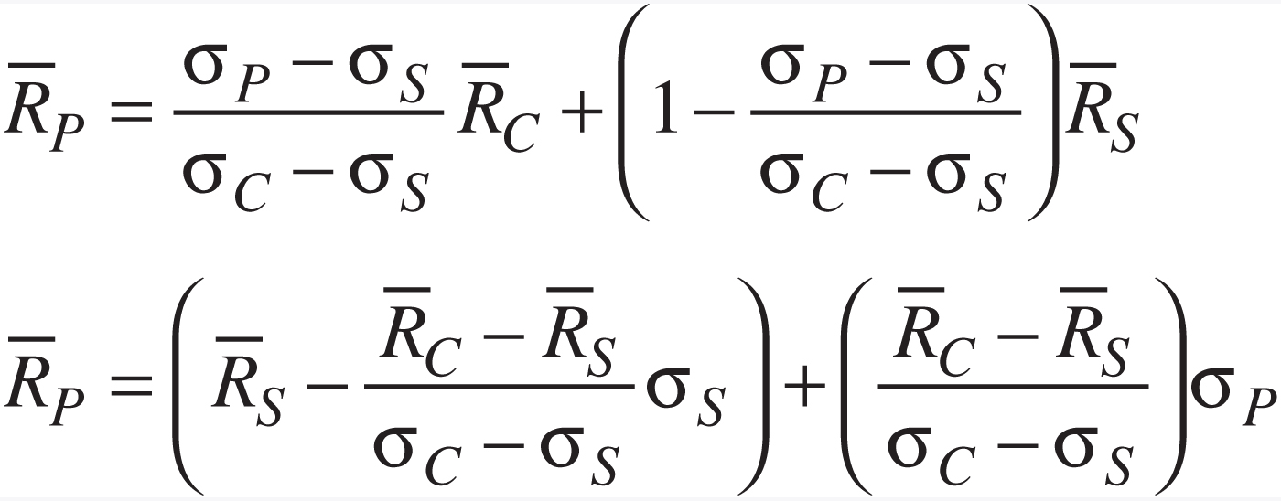
Equn_p67e

Slide 49
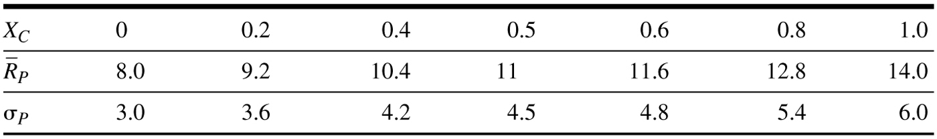
Table _5-1

Slide 50
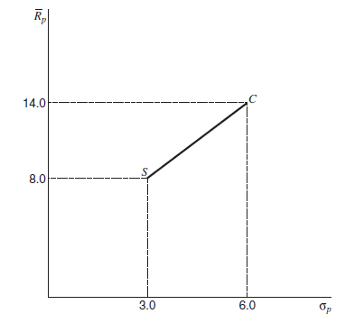
Figure 5.1 Relationship between expected return and standard deviation when p = +1. (No risk saving)

Slide 51
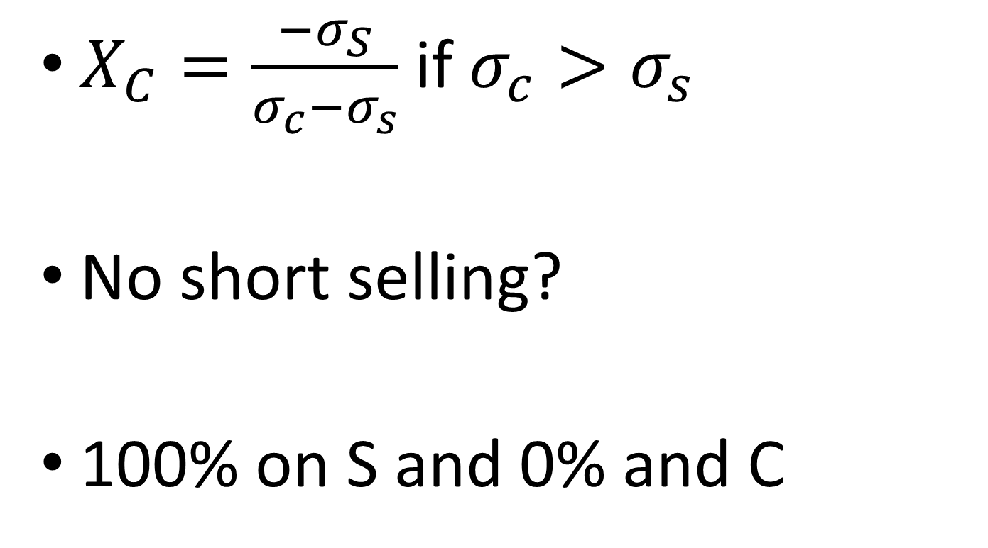
Min risk portfolio (p = 1)
$X_{C}=\frac{−σ_{S}}{σ_{c}−σ_{s}}$ if $σ_{c}>σ_{s}$
No short selling?
100% on S and 0% and C

Slide 52

Case 2 – Perfect Negative Correlation (p = -1)

Slide 53
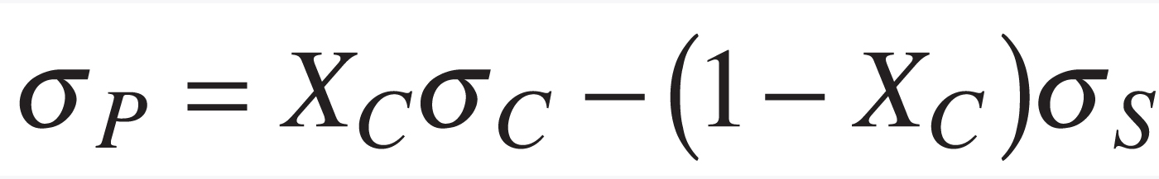
Equn_p69b

Slide 54
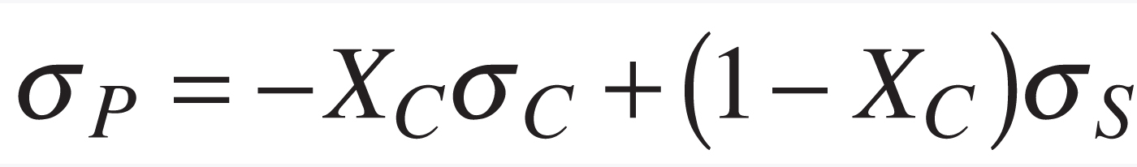
Eq_5-8

Slide 55
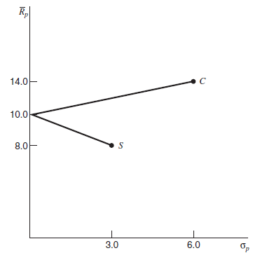
Figure 5.2 Relationship between expected return and standard deviation when p = -1. Arbitage opportunity

Slide 56
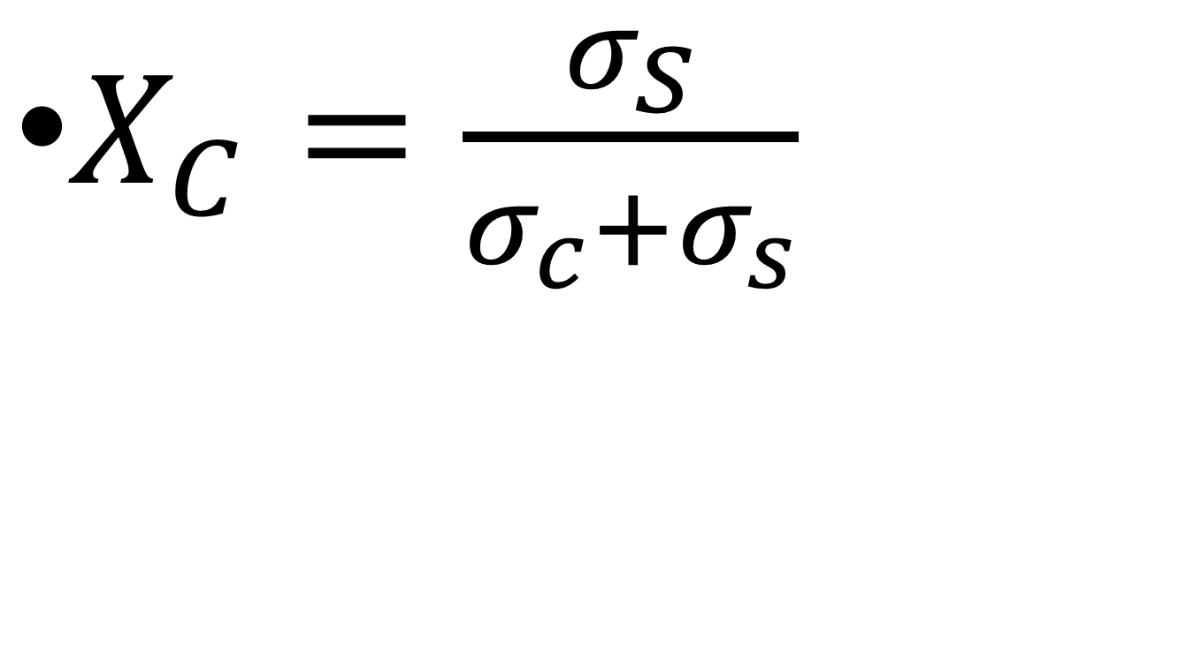
Min risk portfolio (p = -1)
$X_{C}=\frac{σ_{S}}{σ_{c}+σ_{s}}$

Slide 57


Example: Umbrella vs Icecream

Slide 58
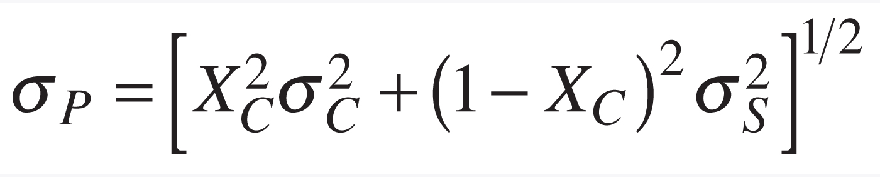
Case 3 – No Correlation (p = 0)

Slide 59
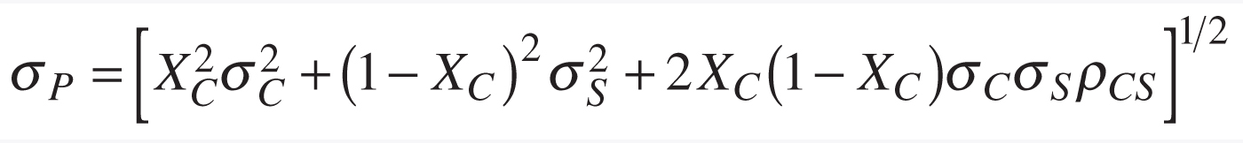
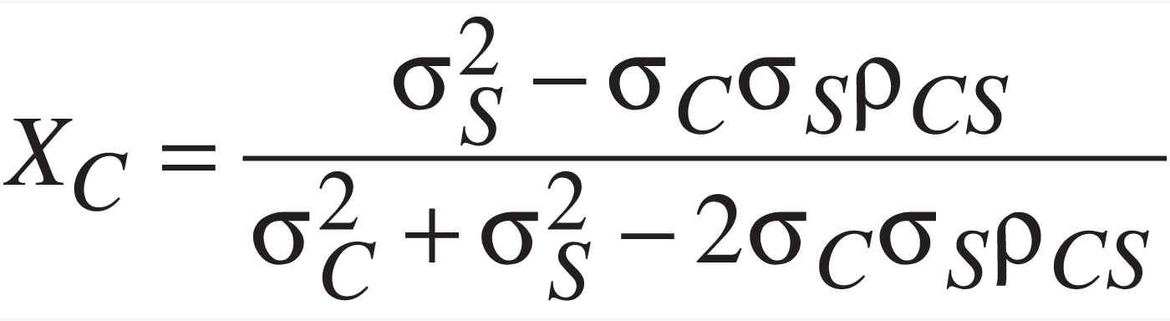
Important
Global minimum portfolio weight (for any two assets)

Slide 60
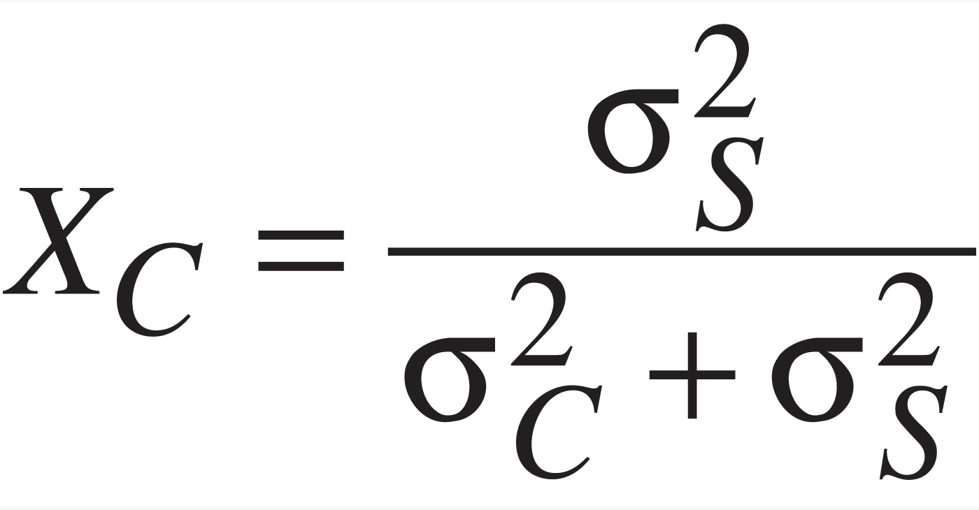
Min risk portfolio (p = 0)

Slide 61
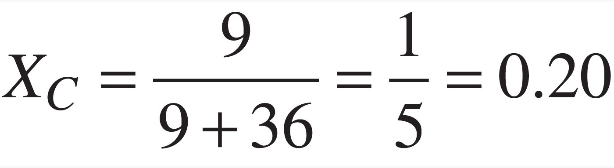
Equn_p73b

Slide 62

Figure 5.4 Relationship between expected return and standard deviation when p = 0.

Slide 63

Case 4 – Intermediate risk (p = 0.5)

Slide 64

Equn_p73d

Slide 65

Figure 5.5 Relationship between expected return and standard deviation of return for various correlation coefficients.

Slide 66

Figure 5.9 The efficient frontier.

Slide 67

Figure 5.10 An impossible shape for the efficient frontier.

Slide 68
Short sales
When an investor expected the return on a security to be negative, short sales made sense.
Even in the case where returns are positive, short sales can make sense, for the cash flow received at time zero from short selling one security can be used to purchase a security with a higher expected return.

Slide 69

Table _5-5

Slide 70
All feasible portfolios lie inside a bullet-shaped region, called the minimum-variance frontier

Slide 71

Fig_5-11

Slide 72
Efficient frontier
The efficient set consists of the envelope curve of all portfolios that lie between the global minimum variance portfolio and the maximum return portfolio. This set of portfolios is called the efficient frontier.
The global minimum variance portfolio is that portfolio that has the lowest risk of any feasible portfolio.

Slide 73

Figure 5.12 The efficient set when short sales are allowed.

Slide 74
The Efficient Frontier with Riskless Lending and Borrowing
The introduction of a riskless asset into our portfolio possibility set considerable simplifies the analysis.
We can consider lending at a riskless rate as investing in an asset with a certain outcome.
Borrowing can be considered as selling such a security short; thus borrowing can take place at the riskless rate.

Slide 75

Equn_p82a

Slide 76

Equn_p82b

Slide 77

Equn_p83

Slide 78

Figure 5.13 Expected return and risk when the risk-free rate is mixed with portfolio A.

Slide 79
How do we find the portfolio with risk-free asset that everyone loves?
The Tangency Portfolio
If there is also a riskless asset (T-Bills), all investors should hold exactly the same stock portfolio!
All efficient portfolios are combinations of the riskless asset and a unique portfolio of stocks, called the tangency portfolio.
In this case, efficient frontier becomes straight line

Slide 80

Figure 5.14 Combinations of the riskless asset and various risky portfolios.

Slide 81

Figure 5.15 The efficient frontier with lending but not borrowing at the riskless rate.

Slide 82

Figure 5.16 The efficient frontier with riskless lending and borrowing at different rates.

Slide 83
Summary
The graph of portfolio mean and standard deviation is nonlinear (unless perfectly correlated)
If we combine T-Bills with any risky stock, portfolios plot along a straight line

Slide 84
Conclusion
Diversification reduces risk. The standard deviation of a portfolio is always less than the average standard deviation of the individual stocks in the portfolio.
In diversified portfolios, covariances among stocks are more important than individual variances. Only systematic risk matters.
Investors should try to hold portfolios on the efficient frontier. These portfolios maximize expected return for a given level of risk.
With a riskless asset, all investors should hold the tangency portfolio. This portfolio maximizes the trade-off between risk and expected return.

Slide 85
Thank You Very Much!

